Slide 1
Continued Fraction

Slide 2

Introduction
Imagine we have a 16/45 rectangle, let’s say we want to divide it into n squares such that each square is of ratio n/1
$$\frac{45}{16}=2+\frac{13}{16} \left(Remainder\right)$$
This is also can be written as: 2 + $\frac{1}{\frac{16}{13}}$ = 2 + $\frac{1}{1+ \frac{3}{13}}$
Now using the same way, we can get
2 + $\frac{1}{1+ \frac{1}{\frac{13}{3}}}=2+ \frac{1}{1+ \frac{1}{4+ \frac{1}{3}}}$
Note that we cannot divide the rectangle to smaller squares
Keep this example in your mind to understand the idea of a continued fraction
45
16
16
16
13
16
16
16
16
16
13
This is a continued fraction
16
16
13
16
Finite Or Infinite?
3
16
16
16
13
16
16
13
16
3
3
3
3
1
1
16
1

Slide 3
Getting Continued Fraction using Euclid’s
We took throughout the course how to get gcd for two integer using Euclid's Algorithm. Let’s take the same example as the previous slide
45 = 2 * 16 + 13
16 = 1 * 13 + 3
13 = 4 * 3 + 1
3 = 3 * 1 + 0
L = N * S + R
Note that the values of N are the same as the Number of colored squares
we used the term hcf → highest common factor instead of gcd because we work with continued fractions!
<-- hcf(45,16)
L = Long Side
N = Continued fraction numbers
S = Short Side
R = Remainder

Slide 4

Continued Fraction General Form
From what wee saw in the last Example a Continued fraction can be written as follows
$\frac{p}{q}=a+\frac{1}{b+\frac{1}{c+\frac{1}{d+\frac{1}{….n} } } }$ where $\frac{p}{q} ∈Z$
As a,b,c,d…… n is Equal to N in Euclid's like the previous slide.
For the previous example we can write it like $\frac{45}{16}=[2;1, 4, 3]$
Fractions
Whole Number

Slide 5

Inverting a Fraction
We calculated $\frac{45}{16}$ but what if we wanted to find the continued fraction of $\frac{16}{45}?$
The answer is very simple we will take the continued fraction of $\frac{45}{16}$ and make the whole number 0 and everything else is the same such that
$\frac{16}{45}$ = [0; 2, 1, 4, 3]
Note: every continued fraction starts with 0 is less than 1.

Slide 6

Example
Find the continued fraction of $\frac{70}{15}$
We will use Euclid’s to find the continued fraction numbers
70 = 4 * 15 + 10
15 = 1 * 10 + 5
10 = 2 * 5 + 0
$\frac{70}{15}$ = 4 + $\frac{1}{1+ \frac{1}{2}}$ = [4; 1, 2]

Slide 7

Finding ordinary fraction from continued fractions
We can use the continued fraction numbers to get the original fraction by using the following: [ ... , a, b ] = [ ... , a + $\frac{1}{b}$]
Example ) Find the original fraction of the continued fraction [4; 5, 2]
[4; 5, 2] = [4; 5 + $\frac{1}{2}]=\left[4;\frac{11}{2}\right]$ = [4 + $\frac{1}{\frac{11}{2}}]=\left[4+\frac{2}{11}\right]=\frac{46}{11}$

Slide 8

Direct conversion of a decimal to a CF
We can converse a decimal number (Such as 2.78) to a continued fraction using a simple method (needs a calculator) following the steps
Write down the whole number
2.78 = [2;……]
Subtract the whole number to get a number between 0 and 1
If the answer is 0 STOP. Else go to step 4
Find $\frac{1}{x}$for the new value
Repeat the four steps again until you reach ZERO.

Slide 9
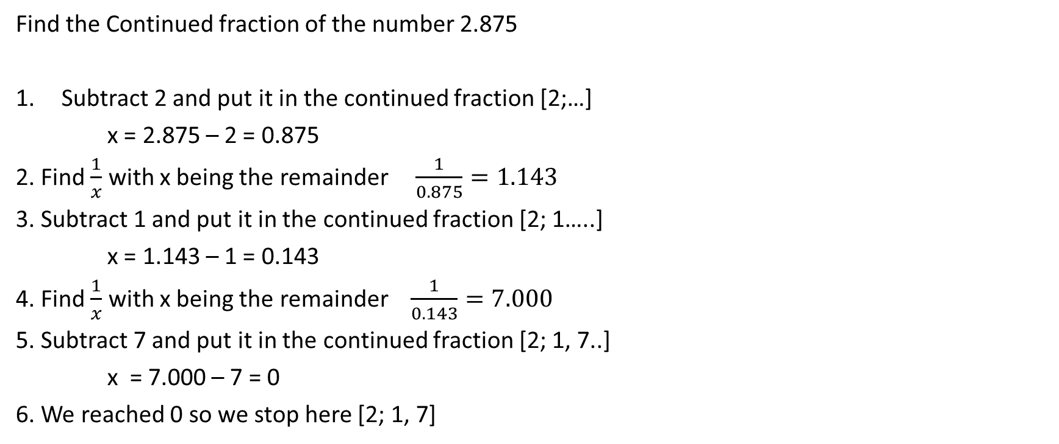
Example
Find the Continued fraction of the number 2.875
Subtract 2 and put it in the continued fraction [2;…]
x = 2.875 – 2 = 0.875
2. Find $\frac{1}{x}$ with x being the remainder $\frac{1}{0.875}=1.143$
3. Subtract 1 and put it in the continued fraction [2; 1…..]
x = 1.143 – 1 = 0.143
4. Find $\frac{1}{x}$ with x being the remainder $\frac{1}{0.143}=7.000$
5. Subtract 7 and put it in the continued fraction [2; 1, 7..]
x = 7.000 – 7 = 0
6. We reached 0 so we stop here [2; 1, 7]

Slide 10

Another way of getting a CF from a decimal
We know that 1.5 = $\frac{15}{10}=\frac{150}{100}$
Using this knowledge, we can get the CF of any decimal number Using Euclid’s let’s try this on the previous example 2.875 = $\frac{2875}{1000}$
2875 = 2 * 1000 + 875
1000 = 1 * 875 + 125
875 = 7 * 125 + 0
CF of 2.875 → [2; 1, 7] the same as in the previous example.

Slide 11

Continued fraction for square roots
Suppose n is not a perfect square and that √n = a + x where a² is any square number less than n. the general formula of √n as a CF is
√n = a + x n = a² + 2ax + x² Square both sides
n − a² = x ( 2a + x) Rearranging to make x a factor
x = $\frac{n −a^{2}}{2a −x}$
Substituting for x in the top equation: √n = a + $\frac{n −a^{2}}{2a −\frac{n −a^{2}}{2a −x} ….}$

Slide 12

Example
Find CF of $\sqrt{6}$
$\sqrt{6}$ = 2 + $x$ $2^{2}$ < 6 < $3^{2}$
$6=4+4x+x^{2}$ Square both sides
2 = 4$x+x^{2}$ = $x$(4 + $x$) Rearranging to make x a factor
$x$ = $\frac{2}{4+x}$
$\sqrt{6}$ = 2 + $\frac{2}{4+\frac{2}{4+x….} }$

Slide 13
References
https://r-knott.surrey.ac.uk/Fibonacci/cfINTRO.html#convergrecurr

Slide 14
Thank You!
Thanks For listening If you have any questions feel free to ask, we will do our best to help you.
Abdulaziz Alkhrashi Mohammed Alberikan

